Slide 1
Mission 13 Remix
Create your own project from Mission 13

Slide 2
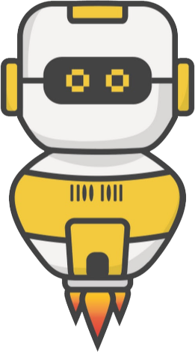
Warm-up
Mission 13 introduced non-blocking sounds and a graphical user interface.
In your Mission 13 Remix Log, answer the pre-mission preparation questions:
Think back to the previous missions. Are there any you would like to make a graphical user interface for, or use non-blocking sound functions?

Slide 3
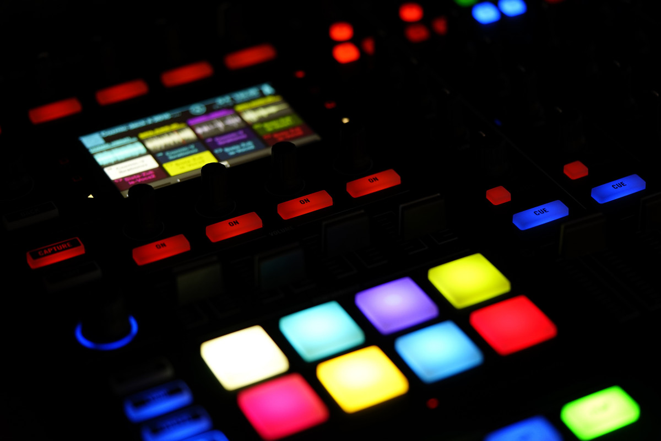
Time for a project remix!
A remix can be:
A new program created by adding new code to a program you already created
You can combine parts of two or more programs in a remix
Use a similar idea in a different way

Slide 4
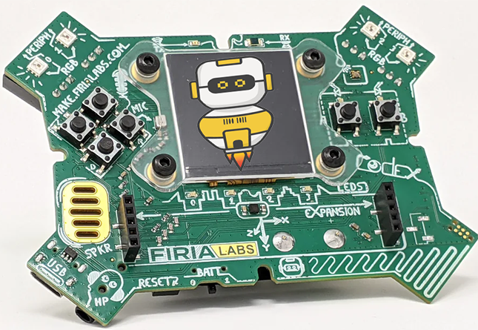
Project Remix
Creating a remix will let you:
Improve your skills and practice the concepts from the mission
Be creative
Remember code from earlier programs and missions
Work with other students
Design an original program and write the code all on your own

Slide 5
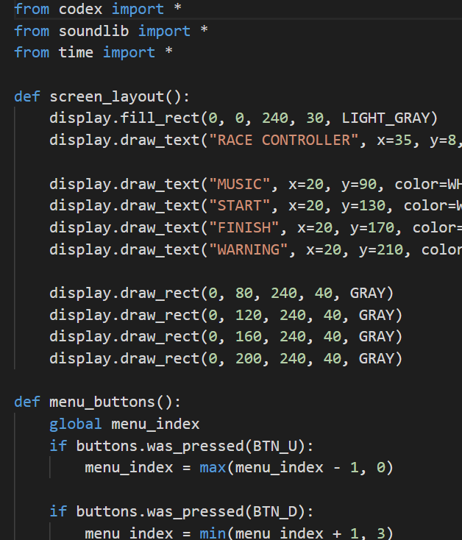
Step #1
Review the mission
Open your project from Mission 13
What does the program do?
What skills were used or concepts learned?
DO THIS:
Fill out the information in the Mission 13 Remix Log for Step 1

Slide 6
Step #2
Brainstorm ideas
Read through remix suggestions from your teacher
Six suggestions are on the next 3 slides. You can use any of these ideas or come up with your own.

Slide 7
Step #2 Remix Ideas
Mild-1A
Use a program from an earlier mission. Add non-blocking music and sounds to the program.
Mild-1B
Use a program from an earlier mission. Add an introduction and/or ending message, and include a border.

Slide 8
Step #2 Remix Ideas
Medium-2A
Create your own musical instruments. Use a GUI to represent different instruments or controls. Use the buttons to play music. Add sound effects to enhance the musical experience.
Medium-2B
Use a program from an earlier mission. Add a toggle for a two-player experience. For example, two different people could have their own personal billboard. Or make the “Reaction Tester” into a 2-player game.

Slide 9
Step #2 Remix Ideas
Spicy-3A
Revisit the “dice roller” remix program. Instead of numbers or images, use circles to draw pips for each die number.
Spicy-3B
Use a program from an earlier mission. Create a graphical user interface for the program.

Slide 10
Step #2
Brainstorm ideas
Read through remix suggestions from your teacher (previous slides)
Use the suggestions as presented, or combine some of the options for your own mild, medium, or spicy project
Use your creativity to come up with your own idea for a project
Decide with your partner what project you will do
DO THIS:
Fill out the information in the Mission 13 Remix Log for Step #2

Slide 11
Step #3
Make a plan
What variables will you need? What will you use them for?
What functions will you create for the program?
What lists will you use, and what will information will they store?
What buttons will you program, and what will each button do?
DO THIS:
Fill out the information in the Mission 13 Remix Log for Step #3

Slide 12
Step #4
Code your project
IMPORTANT: In CodeSpace, go to the sandbox
Start with a new file and give it a descriptive name (Remix13)
You can leave any program open, including Race Control, and use it as a guide
Import your modules
Define your variables (including tones, sounds, etc)
Write your code, testing frequently

Slide 13
Step #4
Stop and test frequently!
Don’t try to write all the code at one time
Think about the steps:
Just get one thing to work, then move on
Step by step!
Mistakes happen, so find them early
Type just a few lines of code and then run the program
If there is an error, fix it before continuing
Use the debugger and your other programs for help

Slide 14
Step #5
Documentation!
Make sure your code is readable by adding blank lines
Add comments to sections of your code that explain what they do

Slide 15
Step #5
Get feedback
Show your code to other students.
What do they think? Have them fill out the feedback form on your Mission 13 Remix Log.
The Mission Log has space for two people to give feedback. The feedback can come from two peers or one peer and yourself.
Modify your code to make your project even better

Slide 16
And now you have your own remix!
Congratulations!
By completing this remix you have:
learned more about programming
practiced the skills and concepts from the missions
been thinking! And problem solving and much more!

Slide 17
Mission Reflection
Wow! Great job!
Share your project with your friends!
Run projects from other students
Complete your Mission 13 Remix Log
Don’t forget to clear your CodeX by running your Clear program

